Slide 1
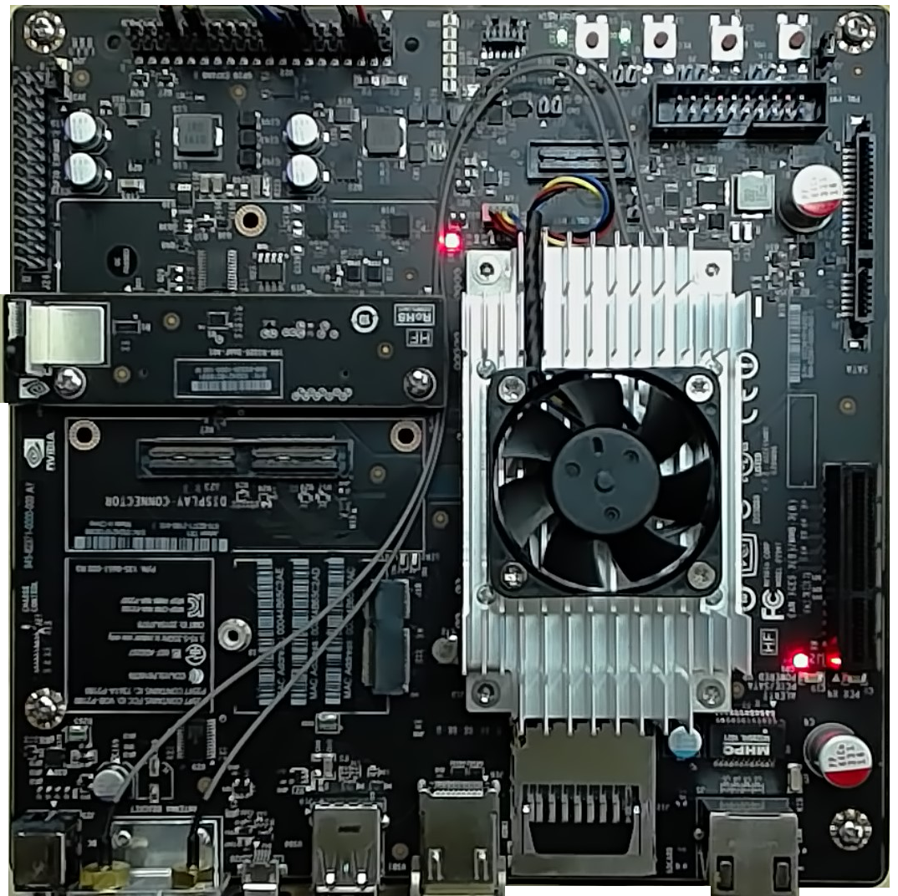


Deep Learning Workshop Architecture
eastus Data Region
dlirw<name>group
Resource Group
LOCAL NETWORK
dlirw<name>-nsg Network Secruity Group
dlirw<name>-vm
YOUR AZURE SUBSCRIPTION
Allow ports 22, 80 & 8888
Login: drcrook
Password: David!234567890 Digts URL: http://<public ip>:8888
Jupyter URL: http://<public ip>:80
Installed Items
nodejs 6.9.4+
Azure-CLI
Web Browser
Assigned
dlirw<name>-vnet Virtual Network
dlirw<name>-nic Network Interface
Attached
ssh to public ip port 22 or http to ports 80, 8888
Public ip: w.x.y.x
Attached
Your Laptop
dlirw<name>-storage storage account
vhds blob container
msftnvidia.vhd blob
We’ll use the azure-cli command line tools to create a new storage account and container in your subscription, copy the source vhd over to your account, and provision the VM with that pre-configured vhd.
msftnvidia.vhd blob
SOURCE
Jetson TX1 caffe models deployed for testing

